Slide 1
Chapter 15
Chapter 15
Visual Culture in Art Education
Visual Culture In Art Education
PRESENTATION BY:
EMMA ADAMS
AND
SANDRA MATTINGLY

Slide 2
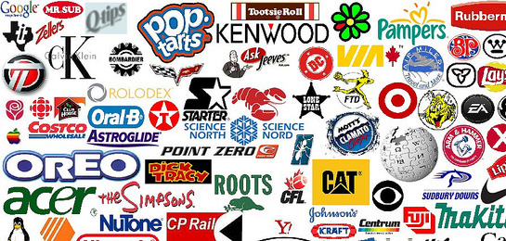
You Know more than you think you do!
We are SUROUNDED by visual culture 24/7
-It is projected that the average person
see’s 287 ads a day
-Technology is responsible for the fastest
increase of visual culture

Slide 3
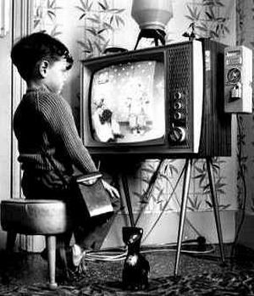
How could this be?!
-Television
-Internet
-Newspapers
-Music videos
-Video Games
-Cell phones

Slide 5
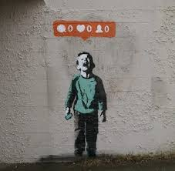
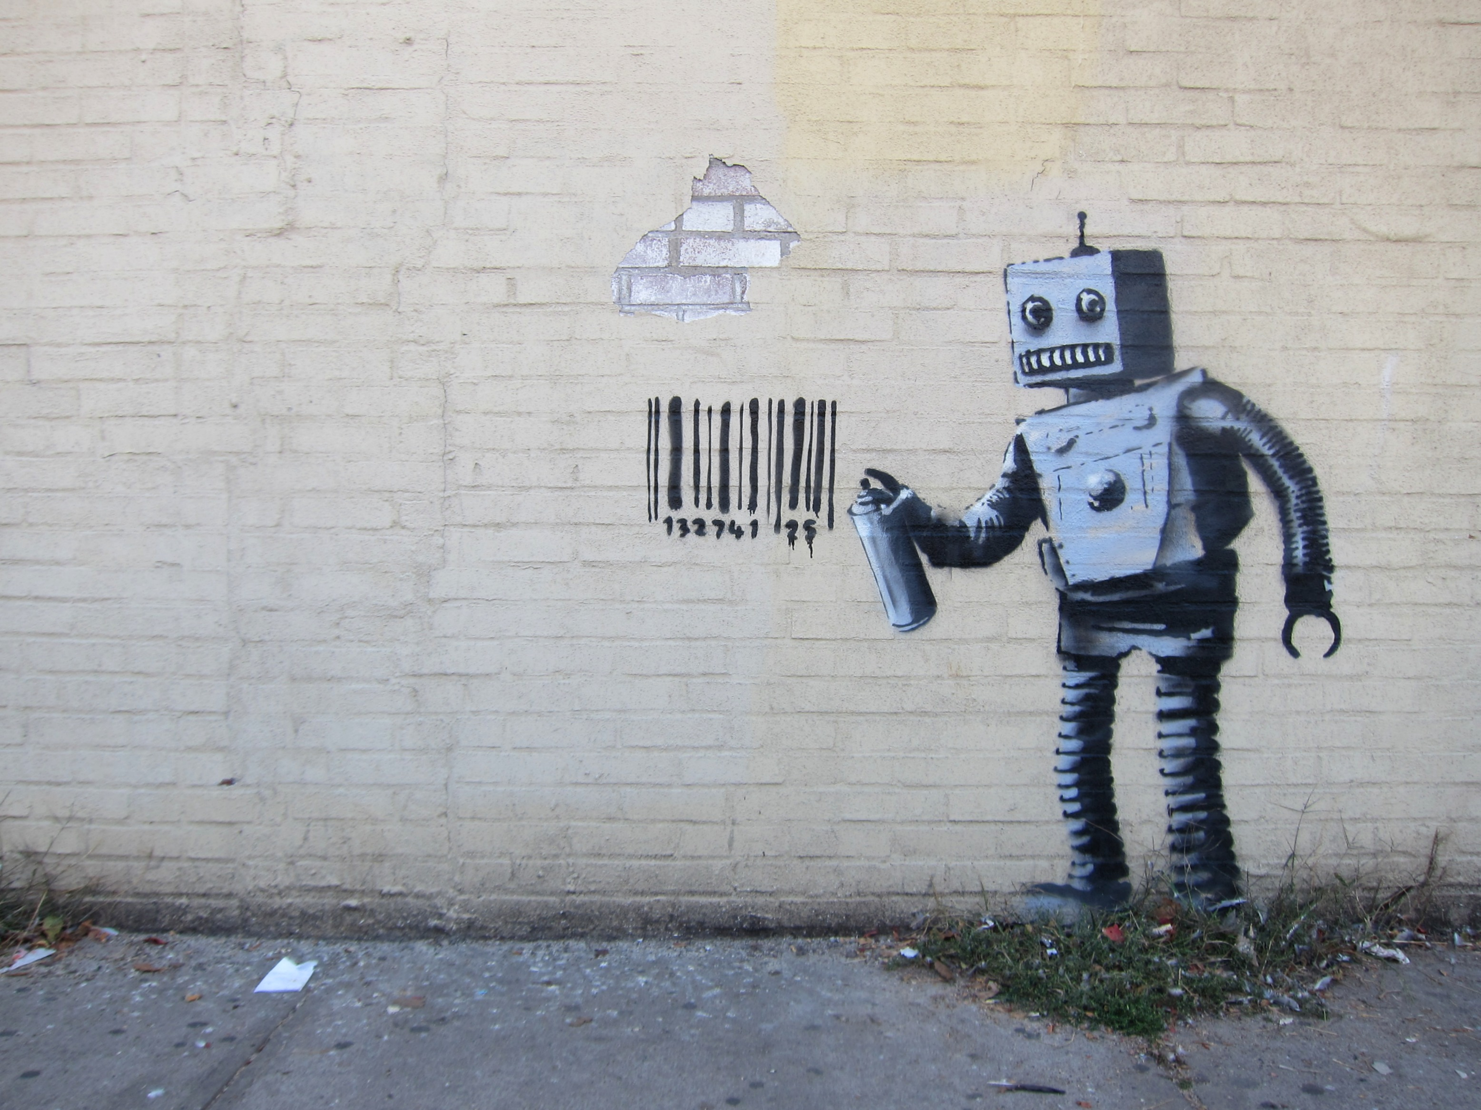
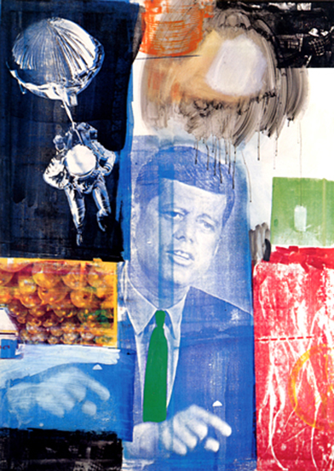
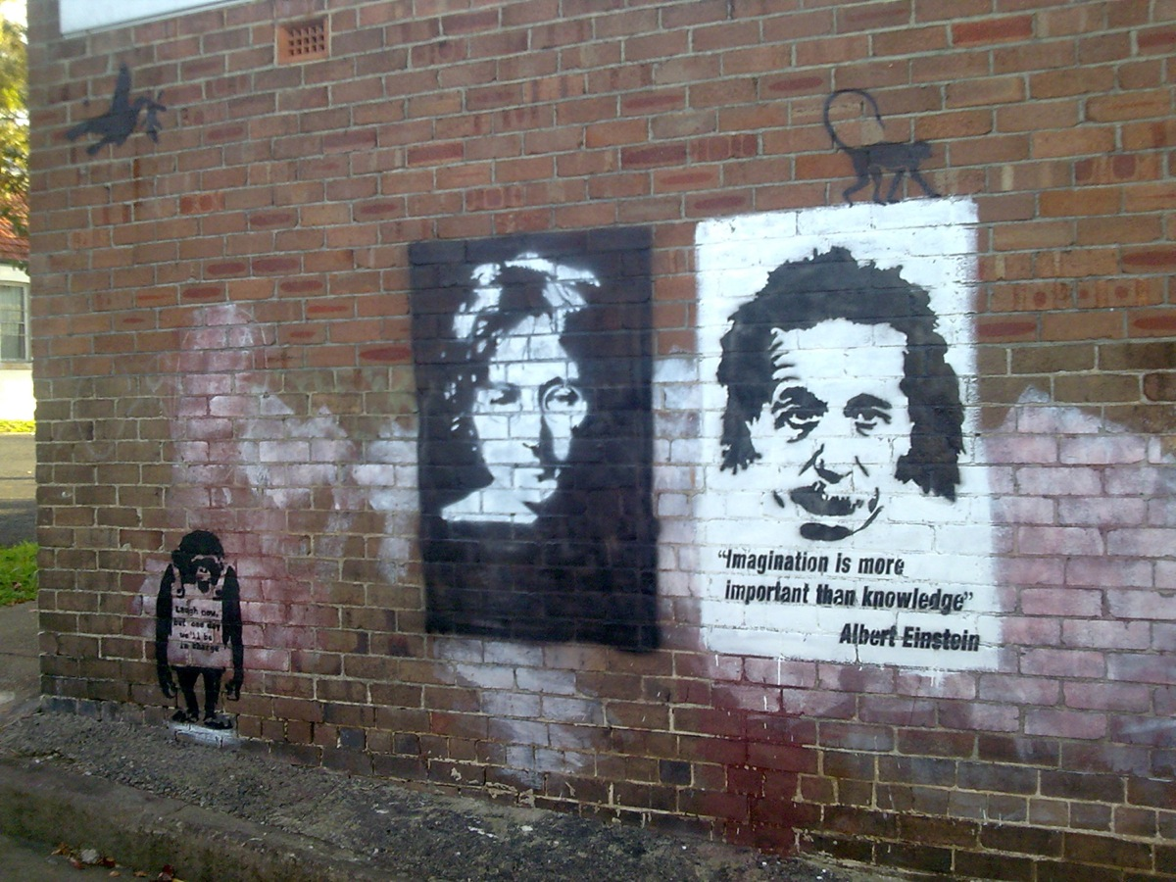
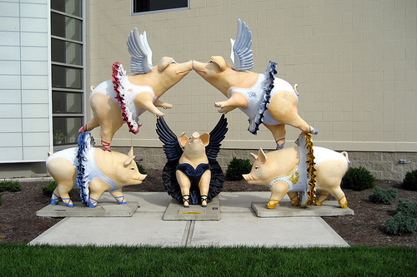
Contemporary Art examples

Slide 6
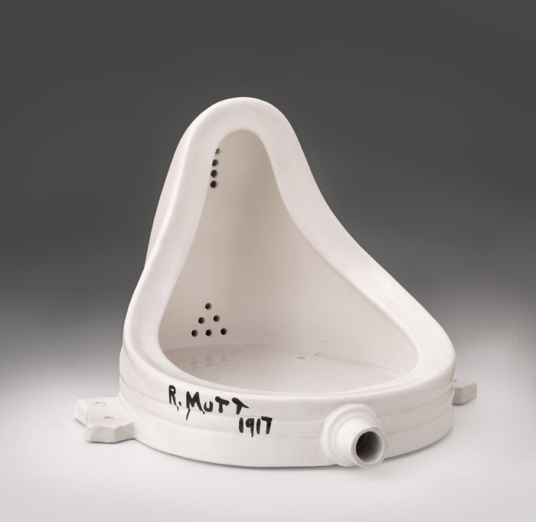
“Not Every thing Is art, yet anything might be transformed into it”
-The Text Book
Visual Culture is also defined by the work of of applied artists
-Architects
-Fashion Designers
-Animators
-interior Designers
These students create majority of the visual culture relevant for art education.
These students also are the individuals who push the boundaries of what is
considered art and what is not.
(Fountain- Marcel Duchamp)

Slide 7
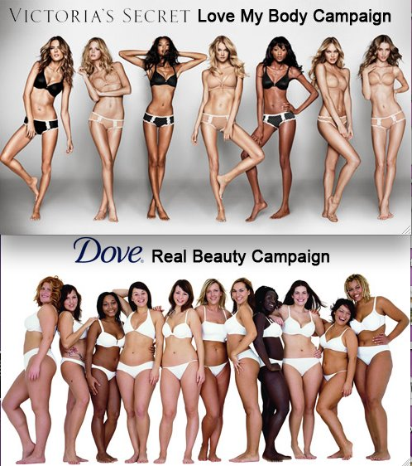
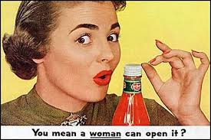
Interpreting Denotations and Connotations
Denotations are are what you literally see in a picture
Connotations are what the things or words imply or suggest
by what they show and how they show it.

Slide 8
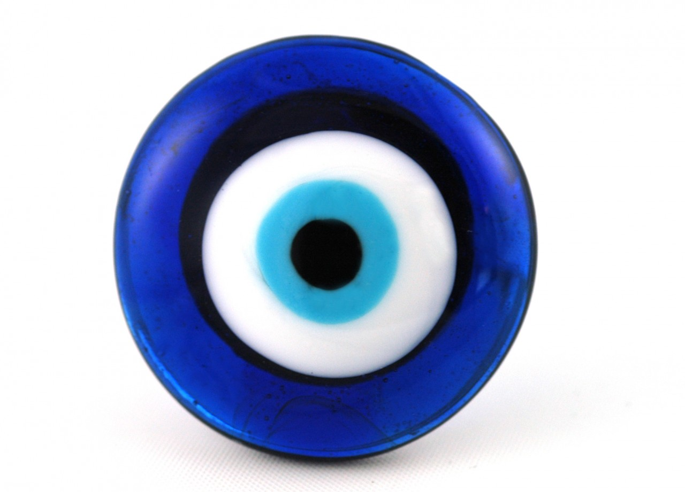
Ethnic Visual Culture

Slide 9
Take a Guess!
Logos and Branding

